Slide 1
Project—Data Visualization of B-factors (Beta Version)
By: Ryan Gumpper

Slide 2
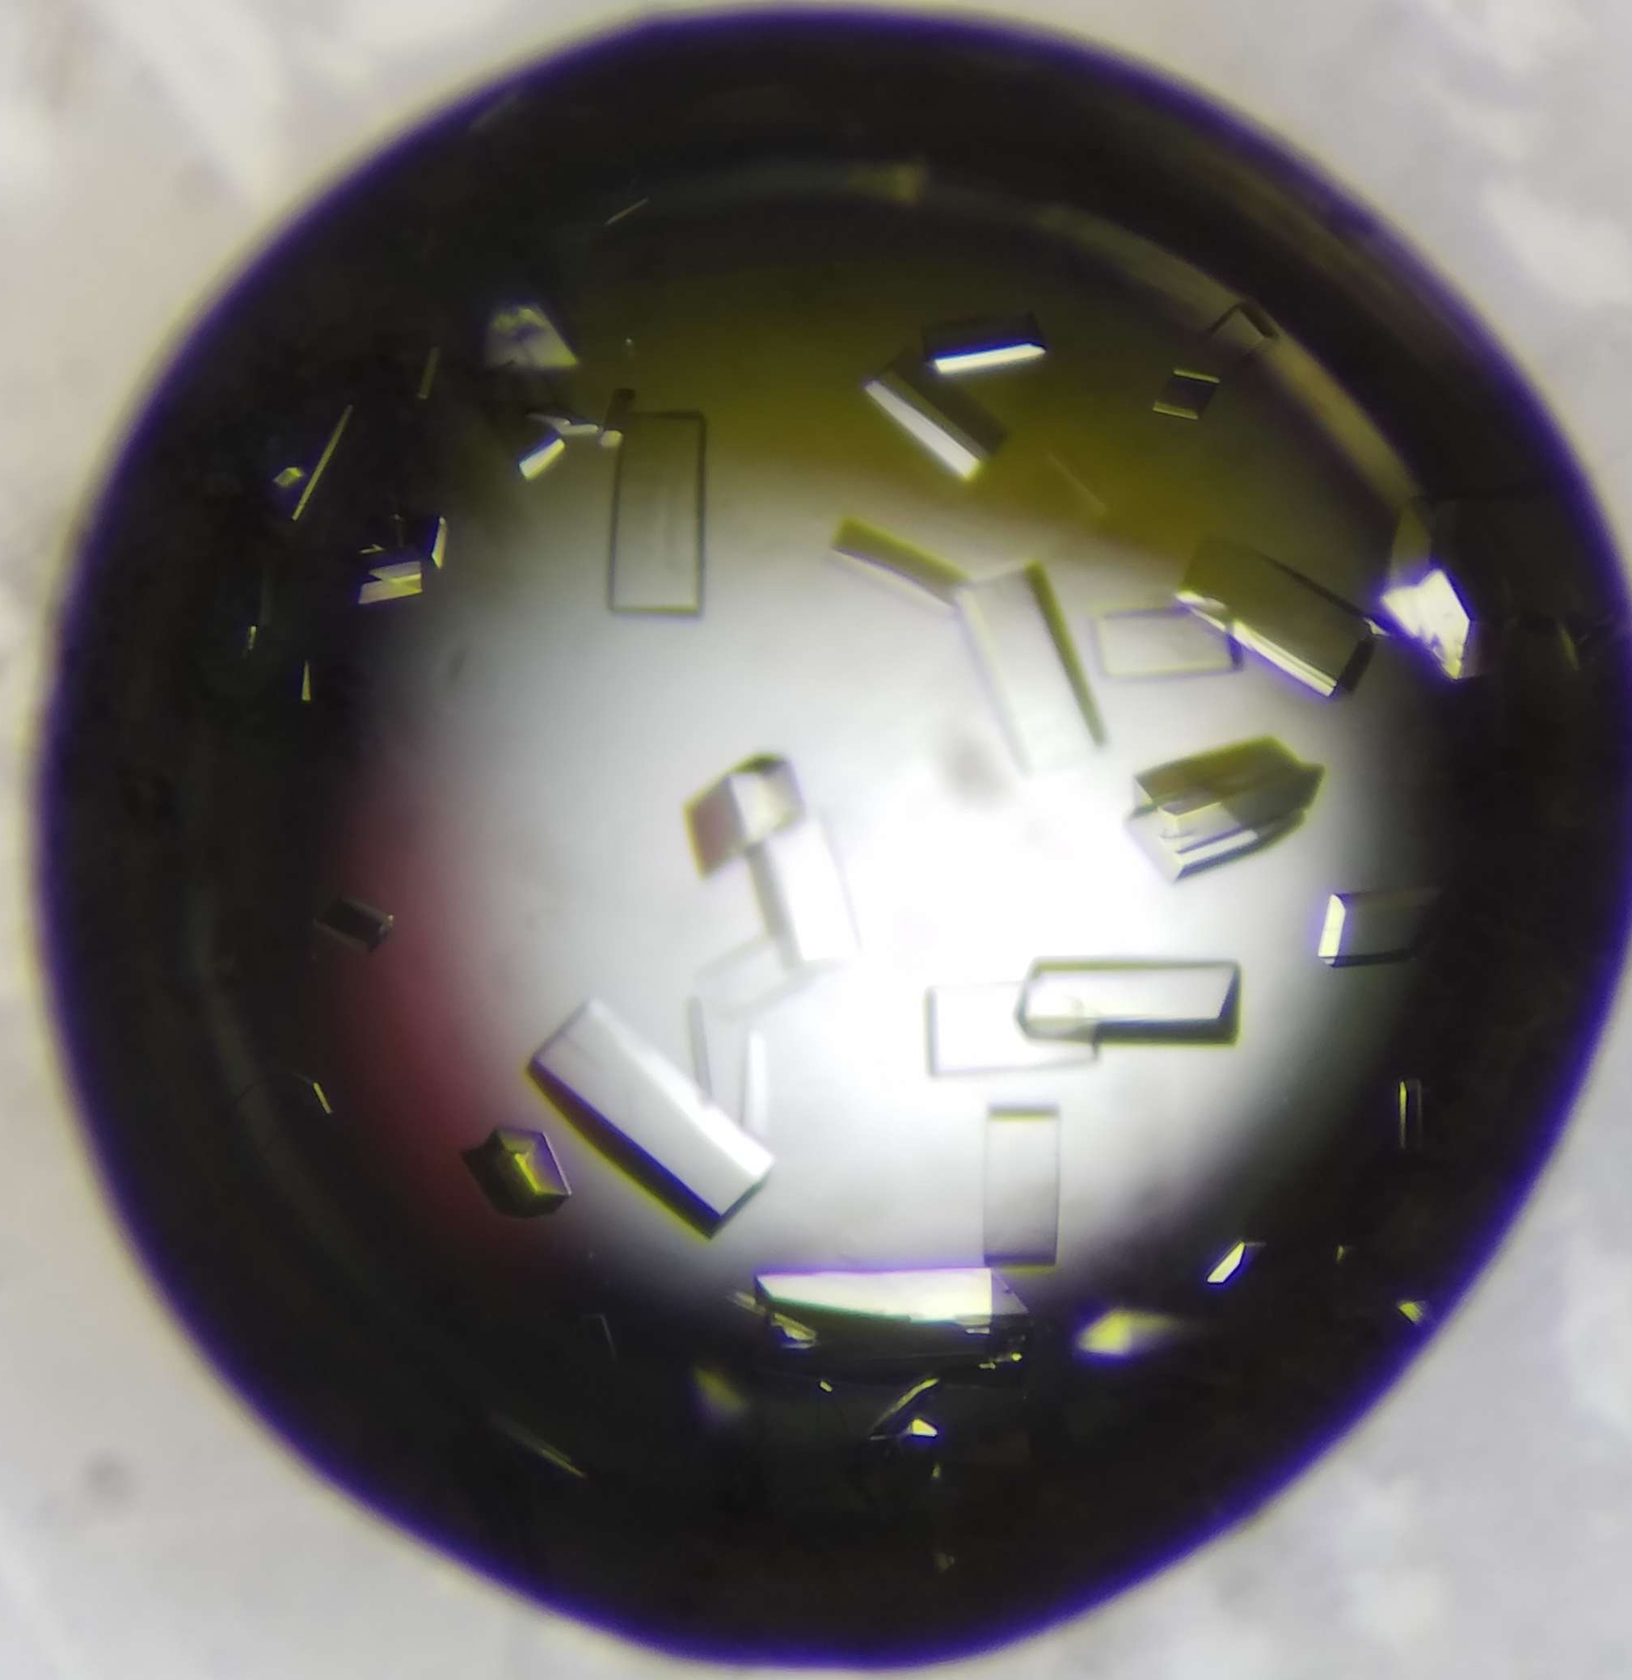
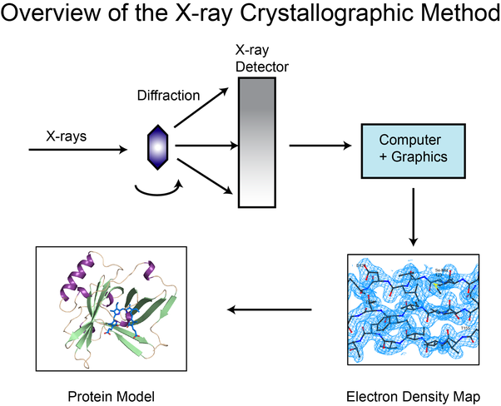
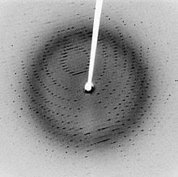
X-ray Crystallography

Slide 3
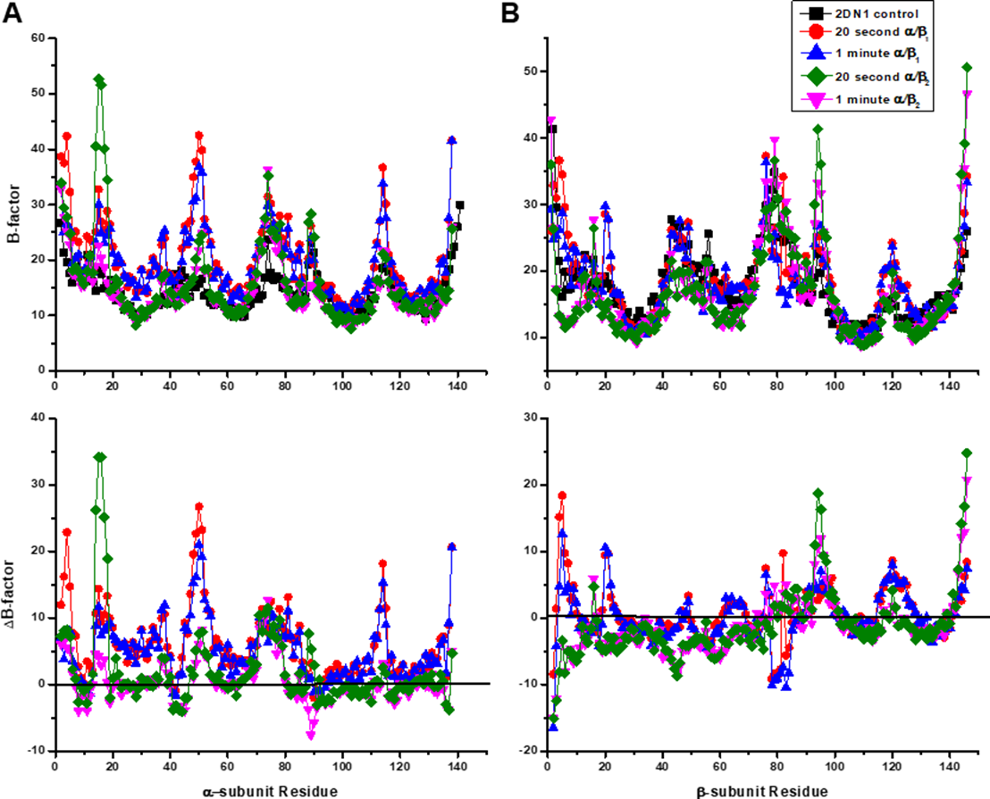
B-factor Plotting

Slide 4
Goal of Project
Take a PDB file—either deposited or to load
Output B-factor plot by residue and graph:
By the protein backbone
By amino acid
Normalize the B-factors if needed (and plot)
Plot 3D and color by B-factor

Slide 5
Libraries Used
Numpy
Pandas
Matplotlib (pyplt and Axes3d)

Slide 6
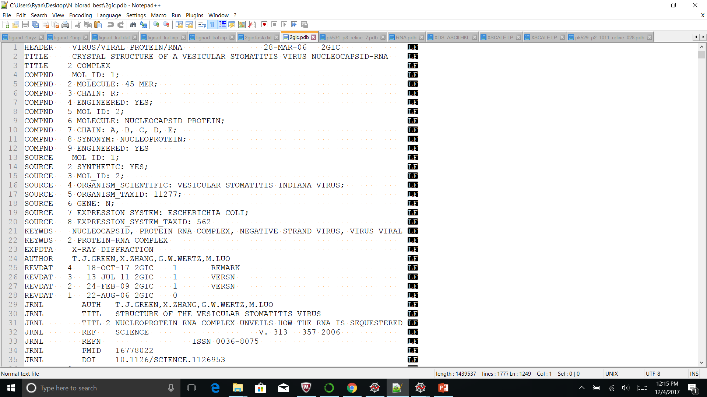
PDB File

Slide 7
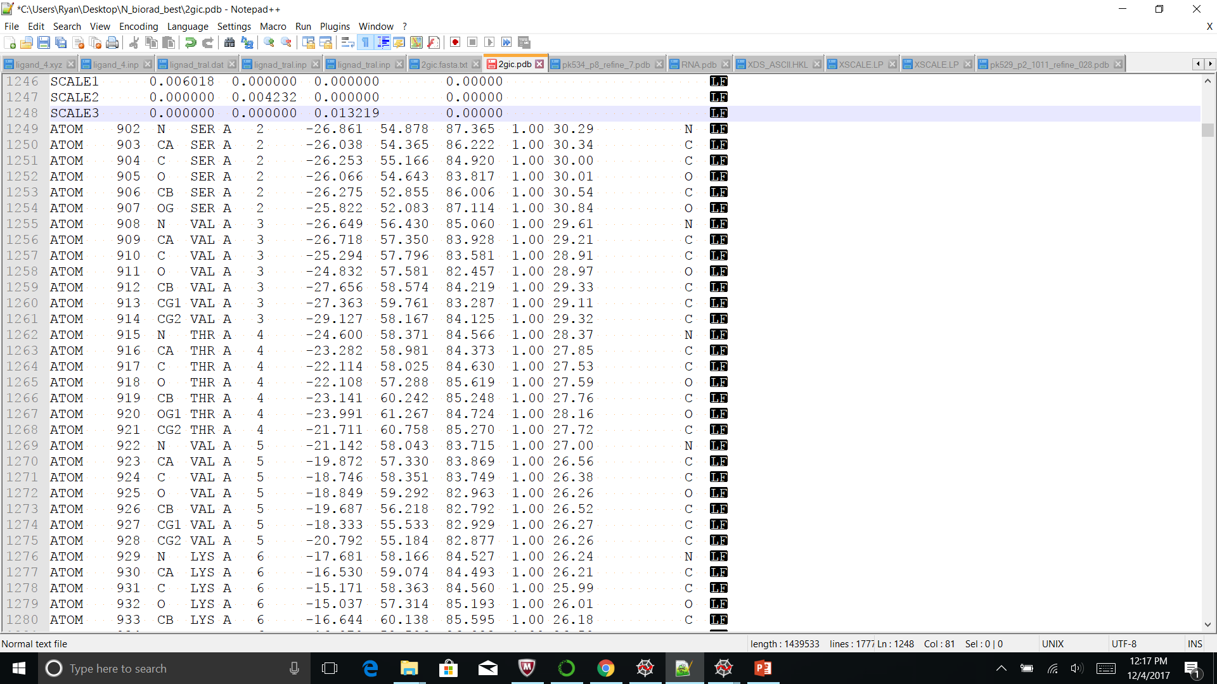
PDB File

Slide 8
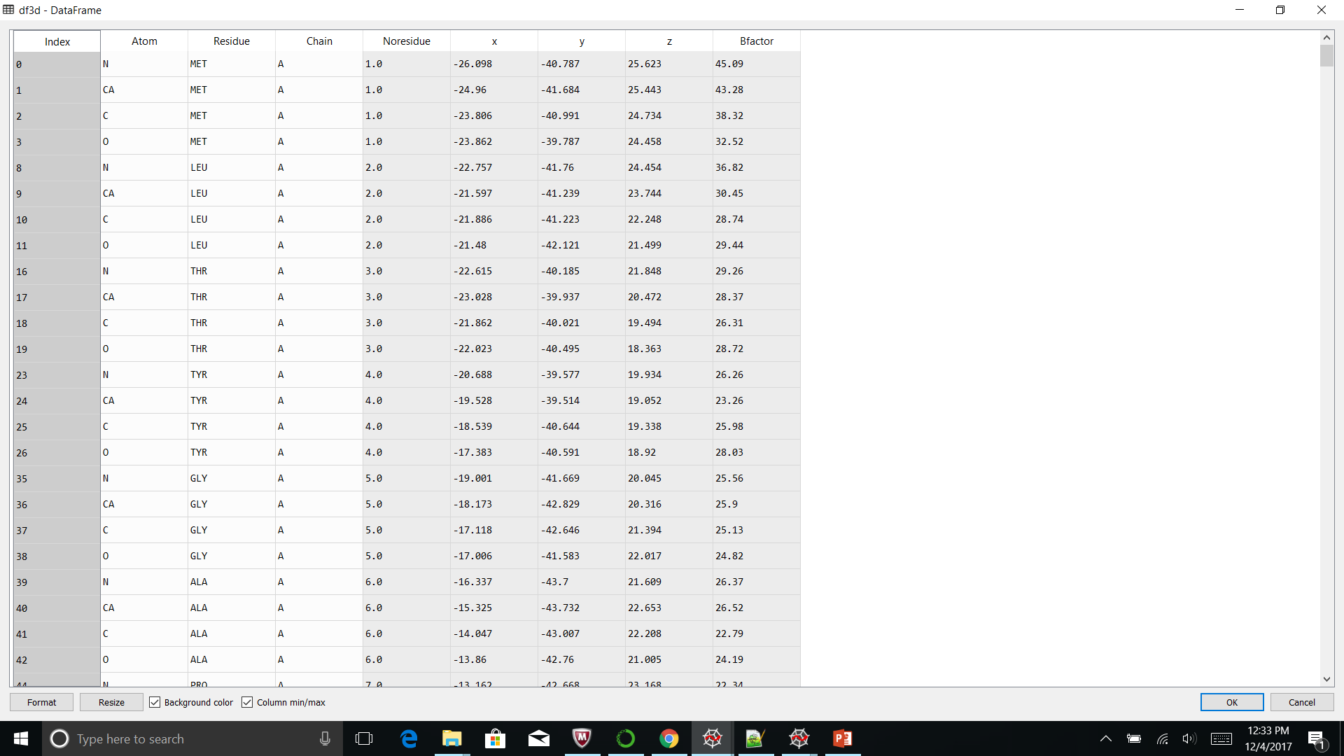
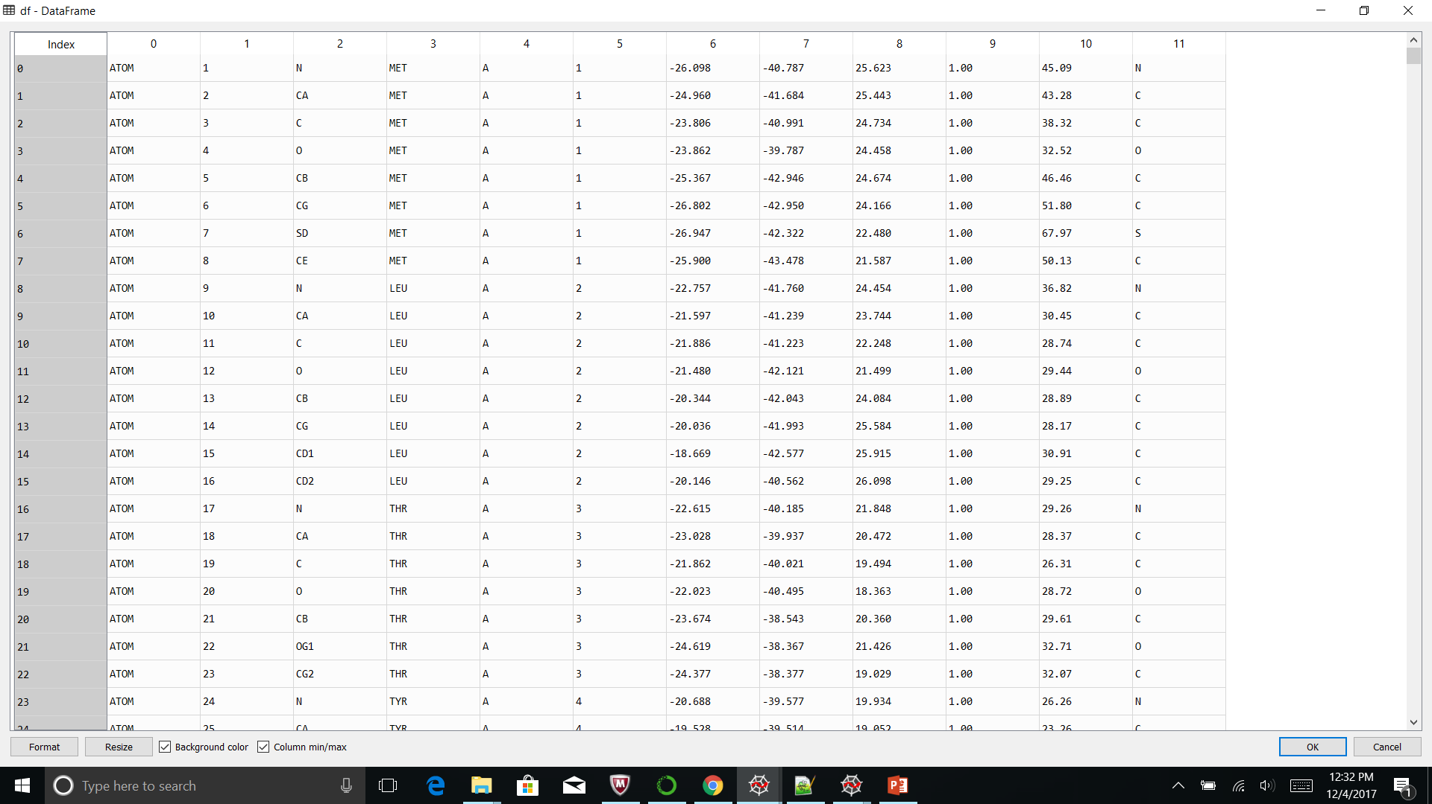
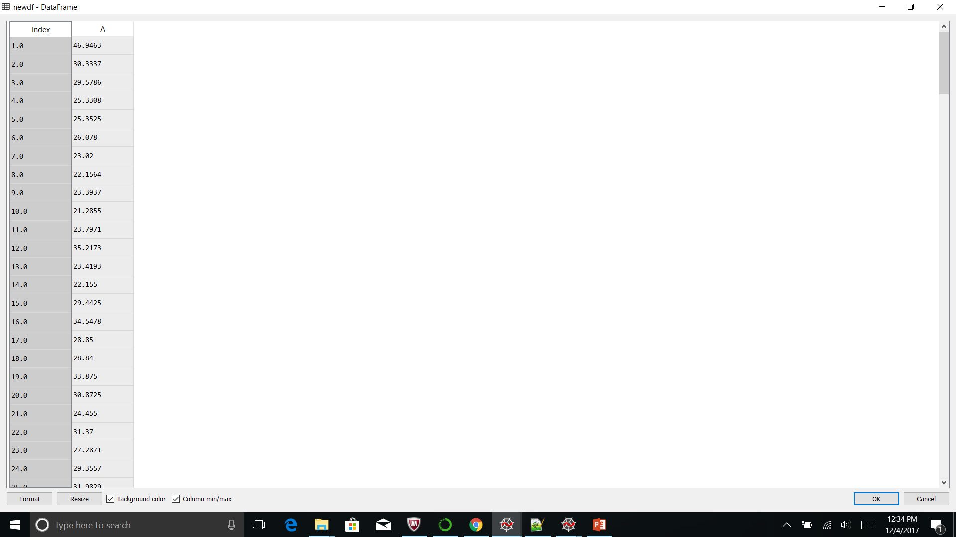
Parse PDB File
Create Array
Make a Pandas DatFrame
Manipulate DataFrame
Plot

Slide 9

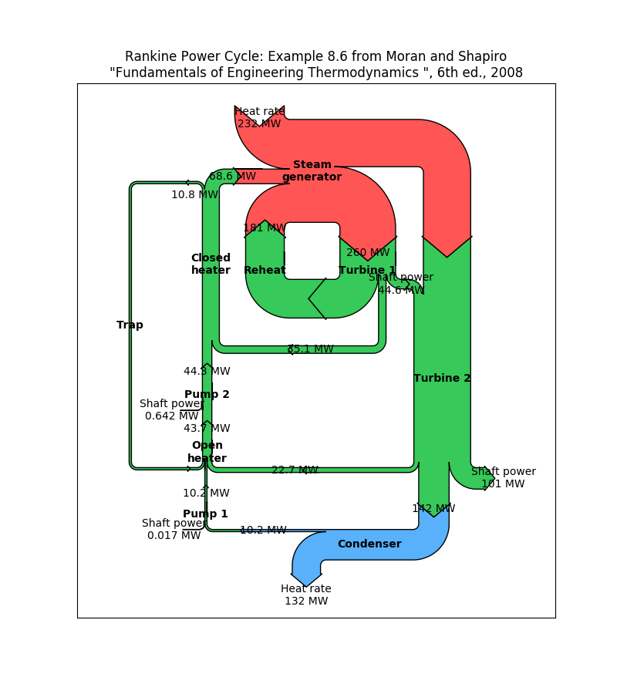
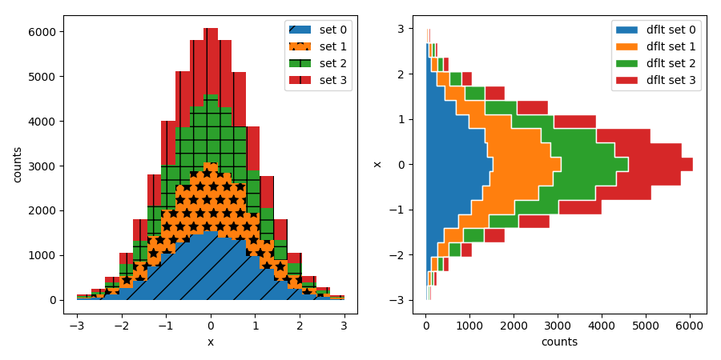
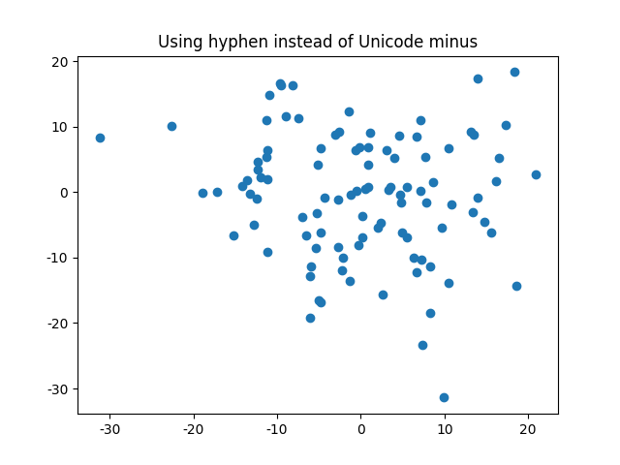
Matplotlib

Slide 10
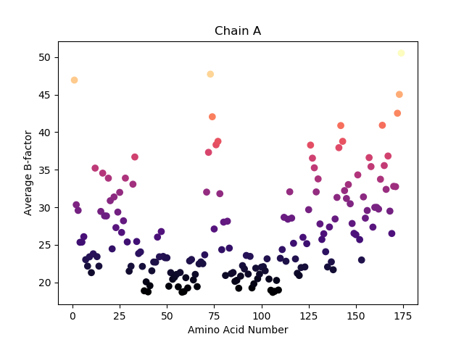
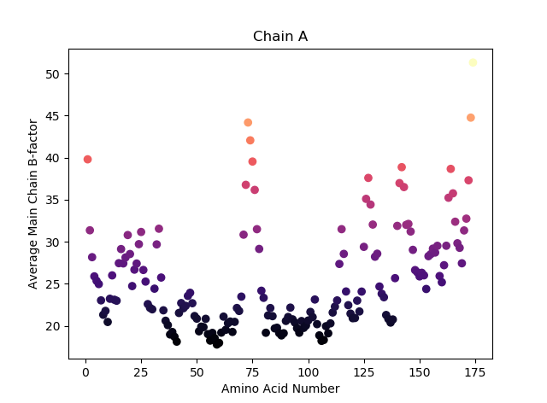
Outputs

Slide 11
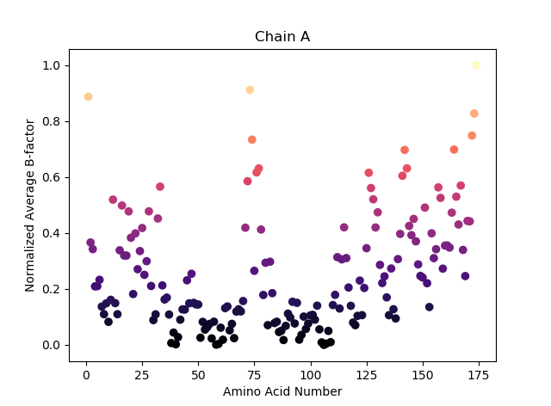
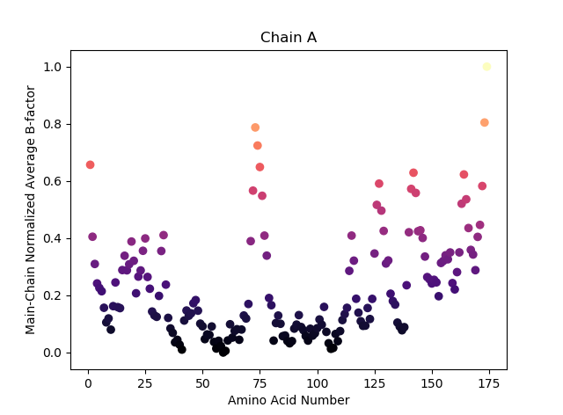
Outputs

Slide 12
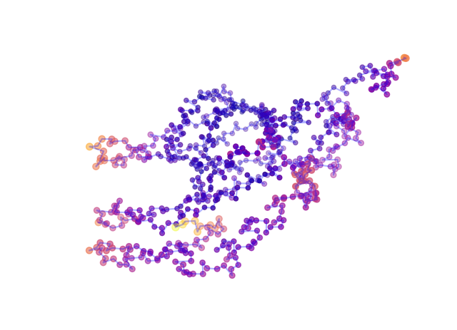
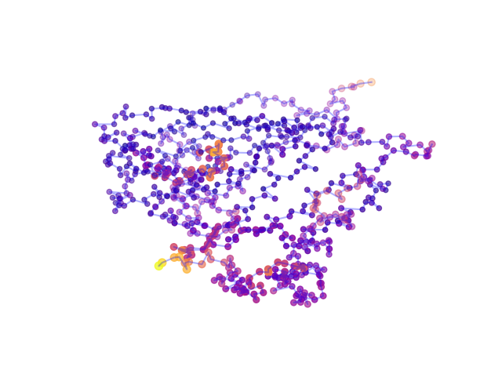
Outputs

Slide 13
Two “Bugs”
Some pdb files won’t convert the B-factors to floats? (seems rare only happened to one file)
Plotting with a line in 3D is challenging to separate protein chains

Slide 14
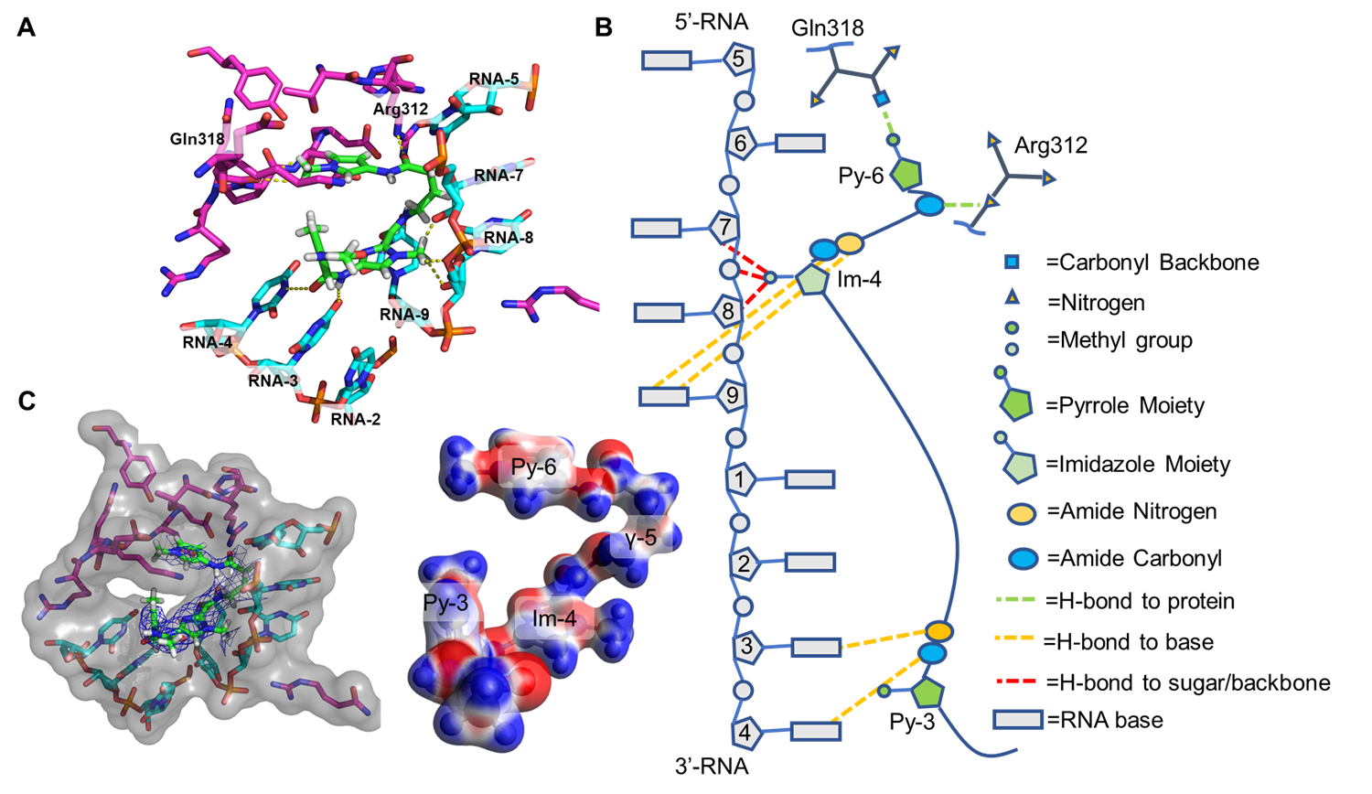
Motif Finder (How this class has helped my research)

Slide 15
Problem
Search a nucleotide sequence for a specific motif i.e. AXXGCTXXC and return the number of times it appears in the sequence and the sequence itself
X is any nucleotide
There are plenty of programs out there to search for known motifs, but none that I could easily find where I could specify the motif

Slide 16
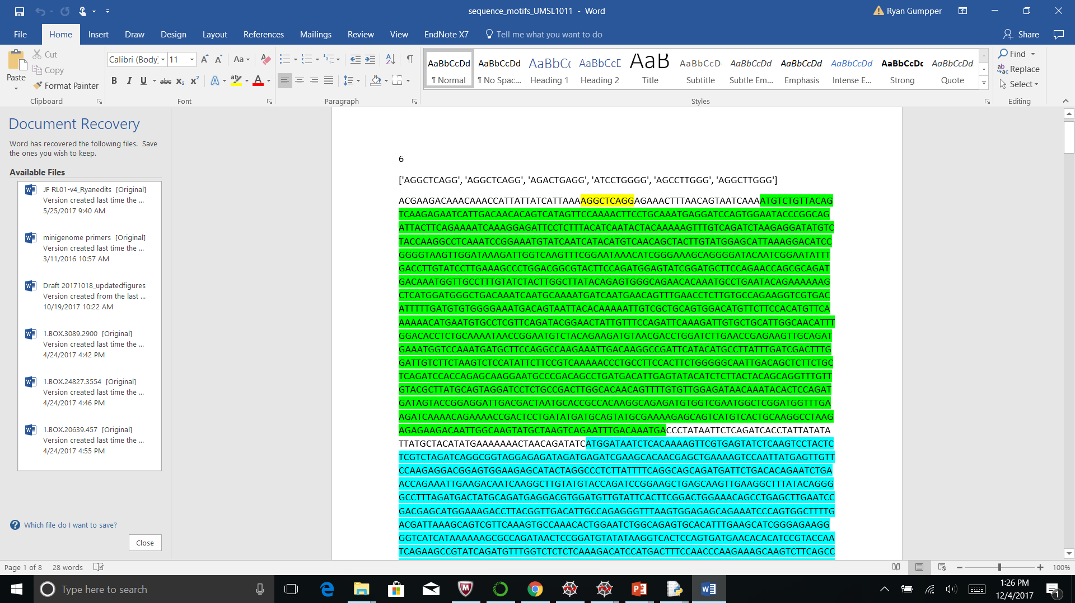
Output
It found 6 on the positive strand and 18 on the negative strand

